Slide 1
Logistic Regression

Slide 2


Regression Classification
House pricing
Person’s income
Email: Spam / Not Spam?
Online Transactions: Fraudulent (yes/no)
Tumor: Malignant/ Benign ?

Slide 3
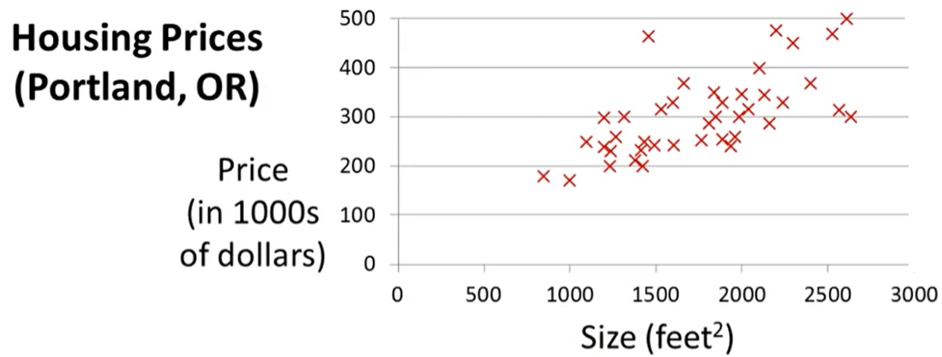
Linear Regression

Slide 4


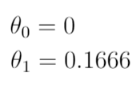

Linear Regression

Slide 5
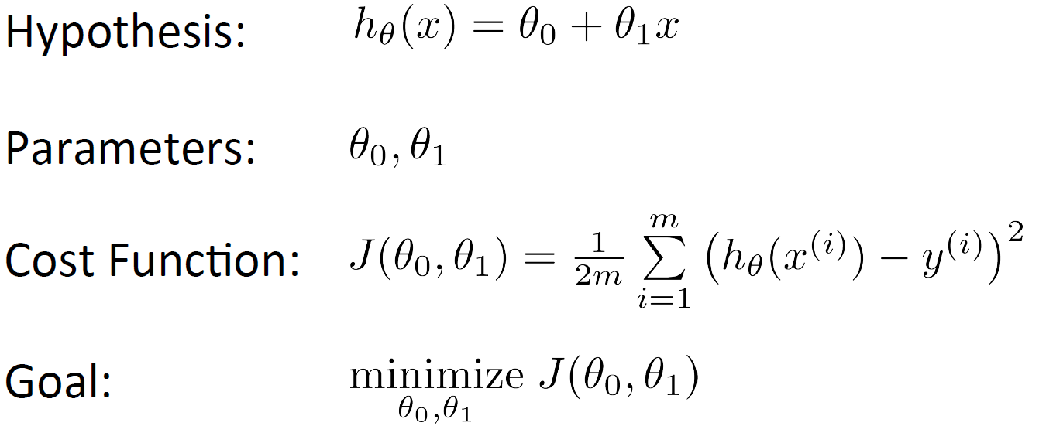
Linear Regression

Slide 6
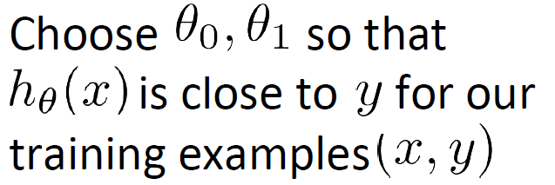
Linear Regression

Slide 7
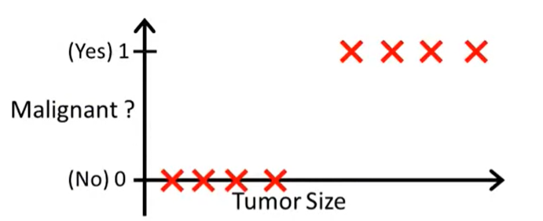
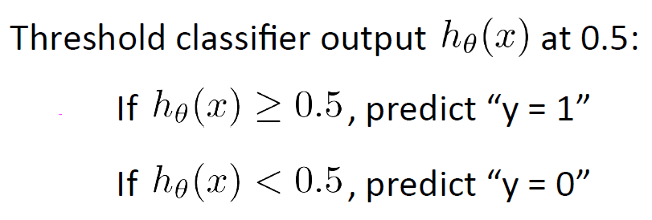
Linear Regression Vs Logistic Regression

Slide 8
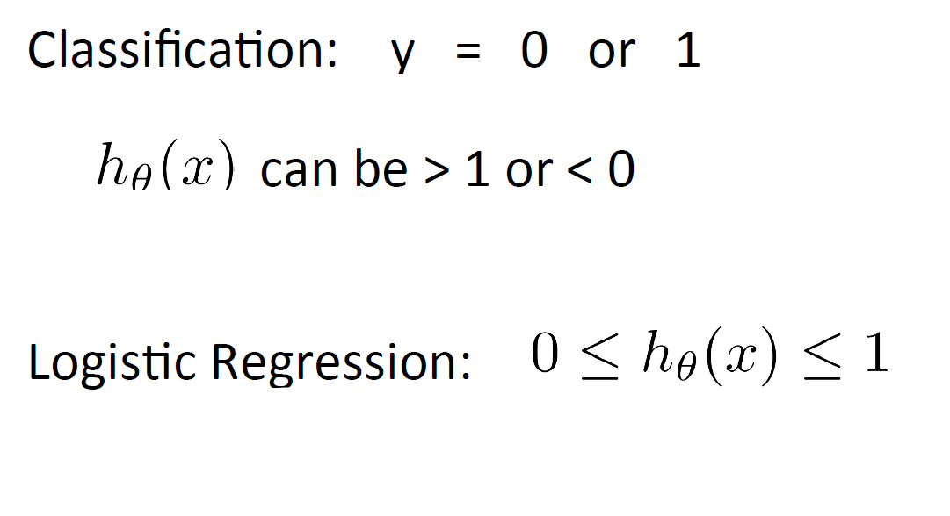
Linear Regression Vs Logistic Regression

Slide 9
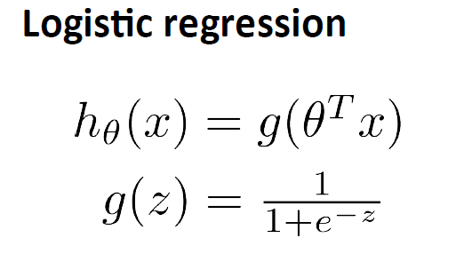




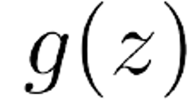

Logistic Regression

Slide 10
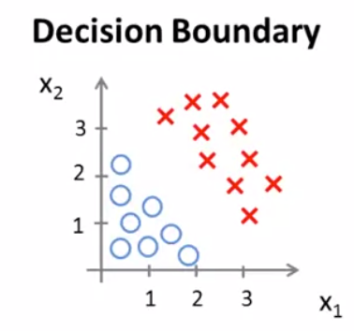




Logistic Regression
-3 1 1
=

Slide 11

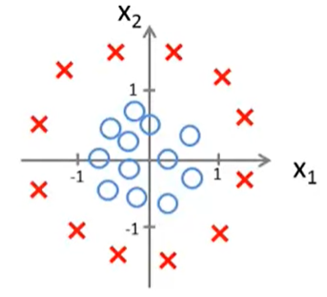


Logistic Regression
-1 0 0
-1 1

